Slide 1

Problem Solving Session
The remainder of today’s class will comprise the problem solving session (PSS).
Your instructor will divide you into teams of 3 or 4 students.
Each team will work together to solve the following problems over the course of 20-30 minutes.
You may work on paper, a white board, or digitally as determined by your instructor.
You will submit your solution by pushing it to GitHub before the end of class.
Your instructor will go over the solution before the end of class.
If there is any time remaining, you will begin work on your homework assignment.
Class participation is a significant part of your grade (20%). This includes in class activities and the problem solving session.
Your Course Assistants will grade your participation by verifying that you pushed your solutions before the end of the class period each day.

Slide 2

Problem Solving Team Members
Record the name of each of your problem solving team members here.
Do not forget to add every team member’s name! Your instructor (or course assistant) may or may not use this to determine whether or not you participated in the problem solving session.

Slide 3
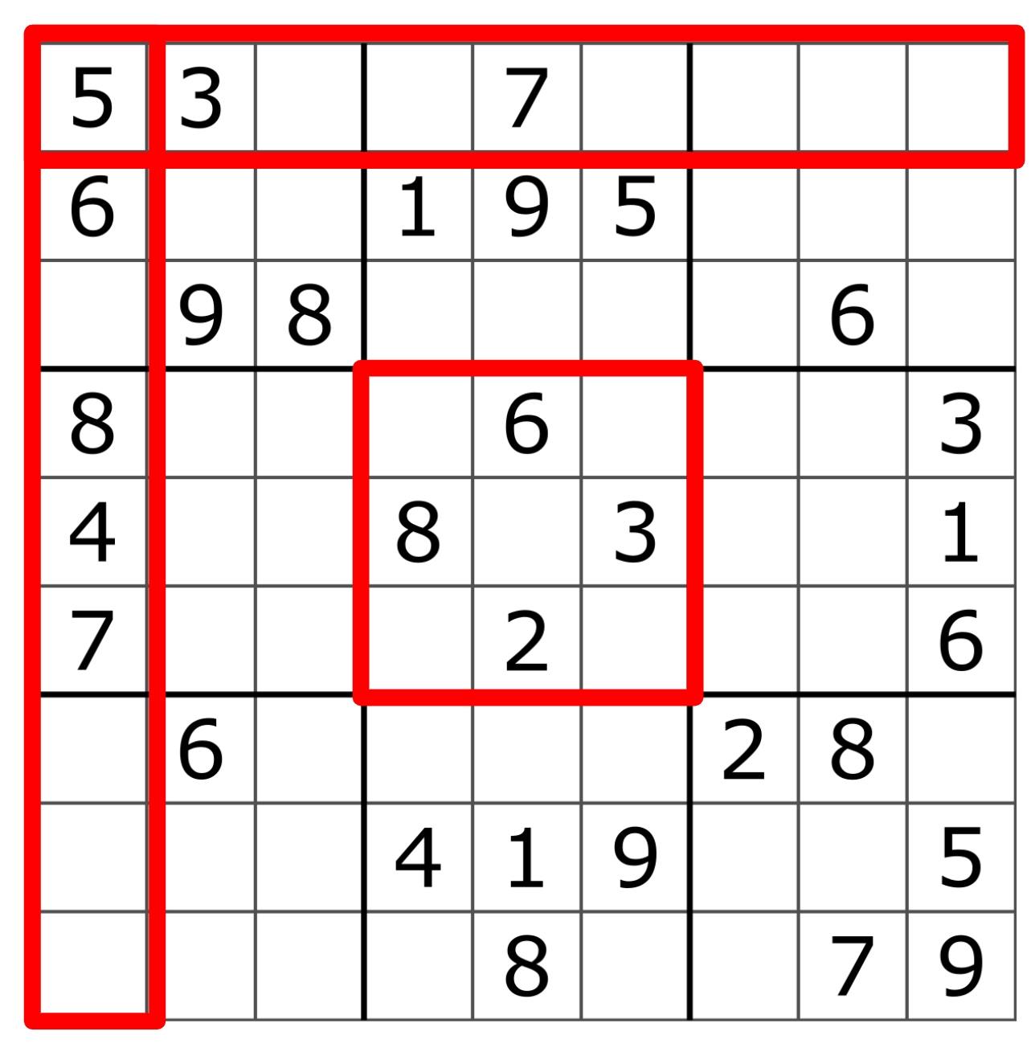
Sudoku
Sudoku is a number logic puzzle game that challenges players to fill a grid with digits ranging from 1 to 9.
The grid is divided into 9 rows and 9 columns.
It is further divided into 9 regions, each of which comprises a 3x3 grid of squares.
A digit between 1-9 must be written in every one of the 81 squares in the grid.
A solution is valid if each digit appears exactly once in each row, column, and region of the board.
A solution is therefore invalid if a digit appears more than once in any row, column, or region.
A partially completed Sudoku puzzle. The red rectangles are used to highlight one row, column, and 3x3 region on the board.

Slide 4
Problem Solving 1
8 | 5 | 6 | 1 |  | 7 | 2 | 9 | 3
1 |  | 9 | 8 | 3 | 6 | 4 | 7
4 | 7 | 3 | 5 |  | 2 | 1 | 6 | 8
2 | 1 | 5 | 7 |  | 3 | 8 | 4 | 9
9 |  | 8 | 4 | 2 | 1 | 7 | 5 | 6
7 | 6 | 4 | 9 | 5 | 8 | 3 |  | 2
5 | 8 | 2 | 6 |  | 4 | 9 | 3 | 1
6 |  | 1 | 3 |  | 9 | 5 | 2 | 7
3 | 9 | 7 | 2 | 1 | 5 | 6 |  | 4
To make sure that everyone has a shared understanding of the rules of Sudoku, complete the puzzle depicted to the right.
Remember, each digit must appear exactly once in each row, column, and region on the board.

Slide 5
Problem Solving 2
7 | 1 | 3 | 4 | 6 | 2 | 5 | 8 | 9
2 | 8 | 4 | 3 | 9 | 5 | 6 | 7 | 1
5 | 9 | 6 | 8 | 1 | 7 | 3 | 4 | 2
1 | 4 | 2 | 6 | 3 | 8 | 7 | 9 | 5
8 | 3 | 7 | 2 | 5 | 9 | 1 | 6 | 4
9 | 6 | 5 | 7 | 4 | 1 | 8 | 2 | 3
4 | 5 | 1 | 9 | 8 | 6 | 2 | 3 | 7
3 | 7 | 8 | 5 | 2 | 4 | 9 | 1 | 6
6 | 3 | 9 | 1 | 7 | 8 | 4 | 5 | 2
The solution to the left is not valid because it contains at least one error. Determine the location of the error(s) and change the text color to red. Then explain the error(s) in the space below.

Slide 6
Problem Solving 3
Consider a file that contains a Sudoku puzzle solution in the format below.
579836412
846152973
312947586
157423698
684579231
923681754
491365827
765218349
238794165
Write a function that, given the name of such a file, will return the file as a two-dimensional list of integers.
Do not worry about error handling. You may assume that the file exists, contains only numeric data, and has the correct configuration of rows and columns.

Slide 7
Problem Solving 4
Write a function that, given a Sudoku puzzle solution as a two-dimensional list, will validate that none of the rows or columns in the board contains the same digit more than once. You should use at least one Python set to keep track of the numbers that have been used.
Do not worry about checking the 3x3 regions for this problem.
Your function should return True if the board is valid with respect to its rows and columns, and False otherwise.

